Slide 1

TELCO CUSTOMER CHURN ANALYSIS
Business Analytics Case Study
AnalystLab Africa Internship Program
Prepared by: Gloria Ubah

Slide 2
EXECUTIVE OVERVIEW
Table of Contents
01
02
03
04
Business Context
Data & Methodology
Key Findings
Strategic Recommendations
Understanding the customer retention challenge and defining analytical objectives
Dataset characteristics, analytical tools, and systematic approach to uncovering churn drivers
Evidence-based discoveries from comprehensive customer churn analysis
Data-driven retention strategies to reduce churn and improve customer loyalty
02

Slide 3
01
BUSINESS CONTEXT
Understanding the customer retention challenge and defining analytical objectives
03

Slide 4
Customer Churn Threatens Revenue and Profitability
THE PROBLEM
PROJECT OBJECTIVES
The company is experiencing significant customer churn, resulting in direct revenue loss and substantially increased customer acquisition costs.
Retaining existing customers is 5-25x more cost-effective than acquiring new ones, making churn reduction a critical strategic priority.
Without data-driven intervention, churn will continue eroding the customer base and competitive position.
Analyze churn patterns across customer segments, services, and contract types
Identify key drivers of customer churn through statistical analysis
Build an interactive dashboard for ongoing churn monitoring
Provide actionable recommendations to improve customer retention
EXPECTED OUTCOMES
A comprehensive understanding of churn drivers with targeted retention strategies to reduce churn rate and improve customer lifetime value.
Source: IBM Telco Customer Churn Dataset (Kaggle)
04

Slide 5
02
DATA & METHODOLOGY
Dataset characteristics, analytical tools, and systematic approach to uncovering churn drivers
05

Slide 6
IBM Telco Dataset Provides 7,043 Customer Records Across 21 Variables
7,043
21
1,869
26.5%
Total Customers
Variables
Churned Customers
Overall Churn Rate
VARIABLE CATEGORIES
Category | Variables | Description
Demographics | gender, SeniorCitizen, Partner, Dependents | Customer personal and household characteristics
Services | PhoneService, MultipleLines, InternetService, OnlineSecurity, OnlineBackup, DeviceProtection, TechSupport, StreamingTV, StreamingMovies | Subscribed telecom and value-added services
Contract & Billing | Contract, PaperlessBilling, PaymentMethod, MonthlyCharges, TotalCharges, tenure | Contract terms, payment preferences, and billing details
Target | Churn (Yes / No) | Whether the customer left within the last month
Source: IBM Telco Customer Churn Dataset (Kaggle)
06

Slide 7
Four-Phase Analysis Pipeline: From Raw Data to Actionable Insights
01
02
03
04
Data Cleaning
Exploratory Analysis
Dashboard Build
Insights
Handled missing values in TotalCharges
Converted data types for numerical analysis
Standardized categorical variables
Tool: Python (Pandas, NumPy)
Statistical summaries and distributions
Correlation analysis of numerical variables
Segmented churn rate comparison
Tool: Python (Matplotlib, Seaborn)
Interactive multi-page dashboard
DAX measures for KPI calculations
Bookmark navigation between views
Tool: Microsoft Power BI
Extract business insights from patterns
Formulate actionable recommendations
Prioritize by impact and feasibility
07

Slide 8
03
KEY FINDINGS
Evidence-based discoveries from comprehensive customer churn analysis
08

Slide 9
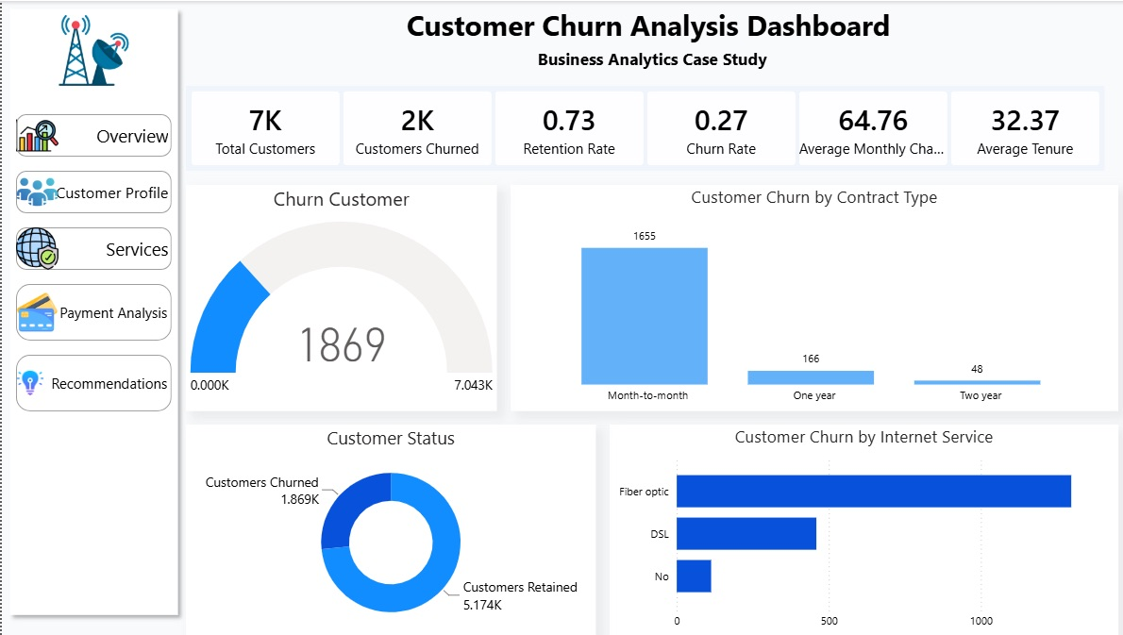
26.5% Churn Rate Concentrated in High-Risk Customer Segments
7,043
1,869
73.5%
$64.76
32.37
26.5%
Total Customers
Customers Churned
Retention Rate
Avg Monthly Charge
Avg Tenure (months)
Churn Rate
KEY INSIGHTS
Month-to-month contracts account for 88.5% of all churn (1,655 customers)
Fiber Optic customers churn at significantly higher rates than DSL users
Electronic Check payers show the highest churn among payment methods
Short-tenure customers (under 10 months) represent the highest churn risk
Source: Power BI Dashboard — Overview Page
09

Slide 10
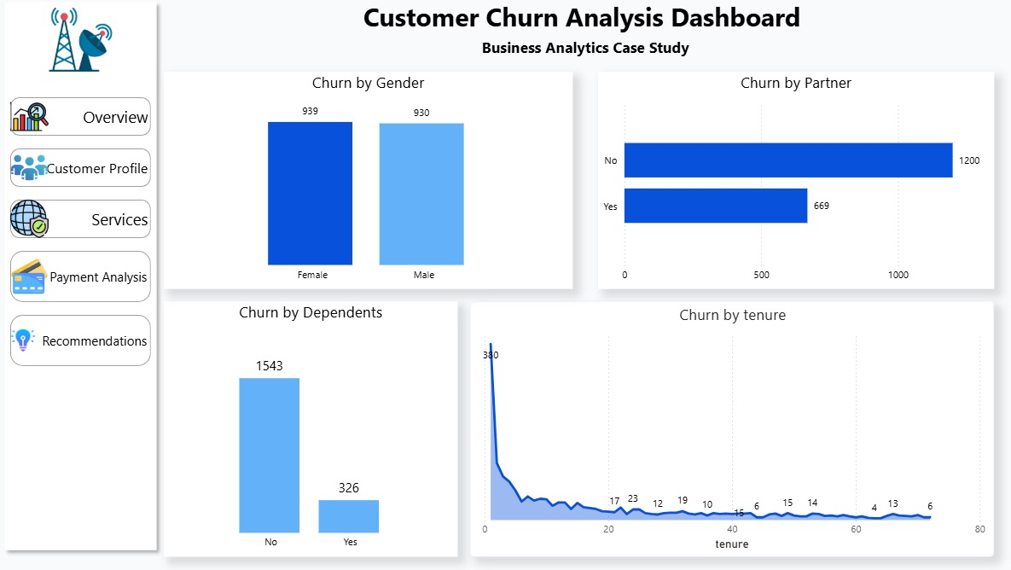
Demographics Reveal Targetable Churn Risk Profiles
DEMOGRAPHIC INSIGHTS
Gender is neutral — Female (939) and Male (930) churn rates are nearly identical
Partner status matters — No partner: 1,200 churned vs With partner: 669
Dependents reduce churn — No dependents: 1,543 vs With dependents: 326
Tenure peaks early — Highest churn at month 1 (380), declining steadily
HIGHEST RISK PROFILE
New customers (<10 months), without partners or dependents, on month-to-month contracts with Fiber Optic service
Source: Power BI Dashboard — Customer Profile Page
10

Slide 11
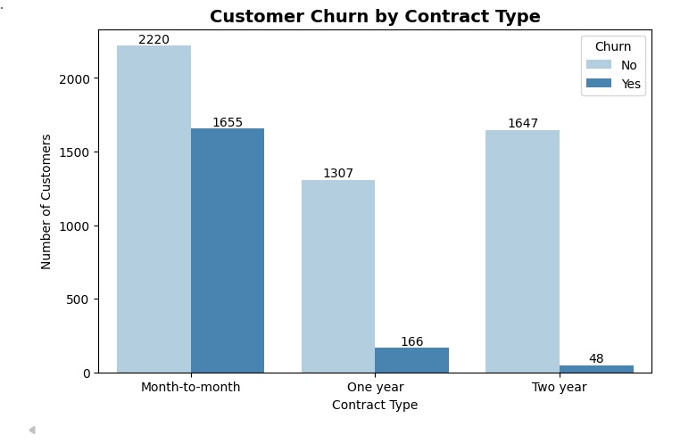
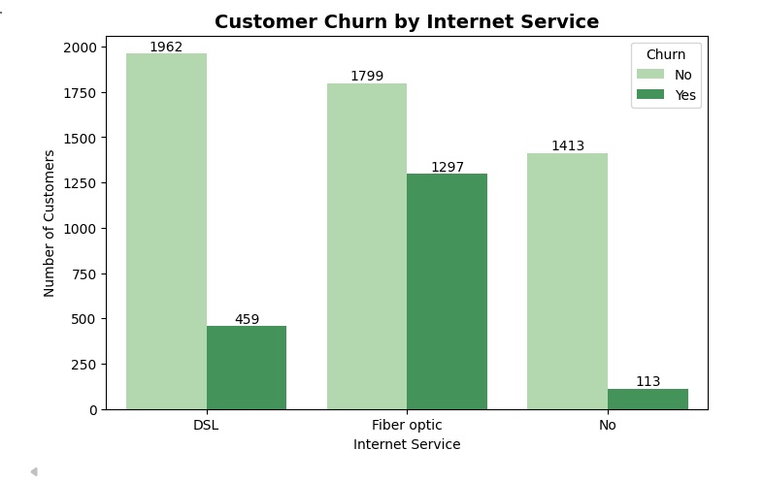
Month-to-Month Contracts Drive 88.5% of All Customer Churn
CHURN BY CONTRACT TYPE
CHURN BY INTERNET SERVICE
1,655
1,297
48
Month-to-month churned
Fiber Optic churned
Two-year contract churned
88.5% of total churn from flexible contracts
Highest churn rate among internet services
Long-term contracts show strong retention power
Source: Python Analysis — Contract Type & Internet Service Charts
11

Slide 12
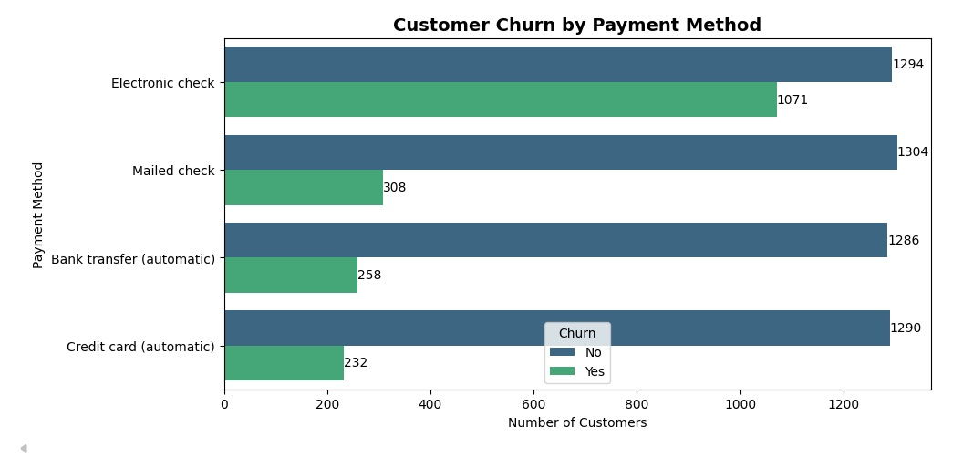
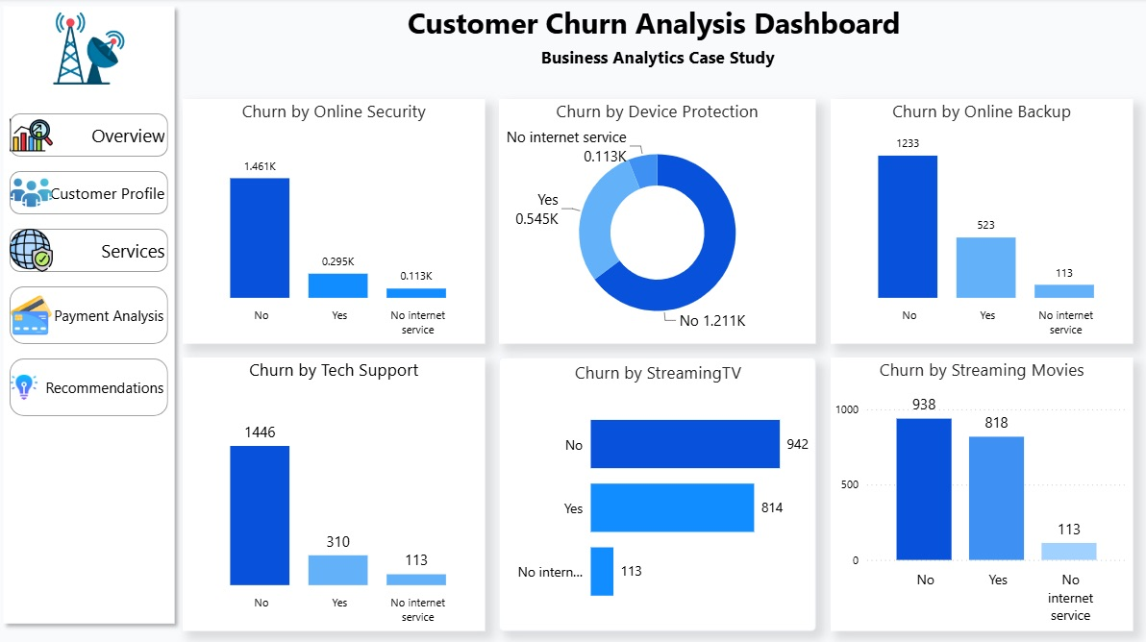
Payment Method and Service Gaps Amplify Churn Risk
CHURN BY PAYMENT METHOD
SERVICE PROTECTION ANALYSIS
1,294
1,461
1,446
Electronic Check churned
No Online Security churned
No Tech Support churned
Manual payment correlates with higher exit risk
Value-added services drive retention
Support services are critical churn preventers
Source: Python & Power BI — Payment Method Chart, Services Dashboard
12

Slide 13
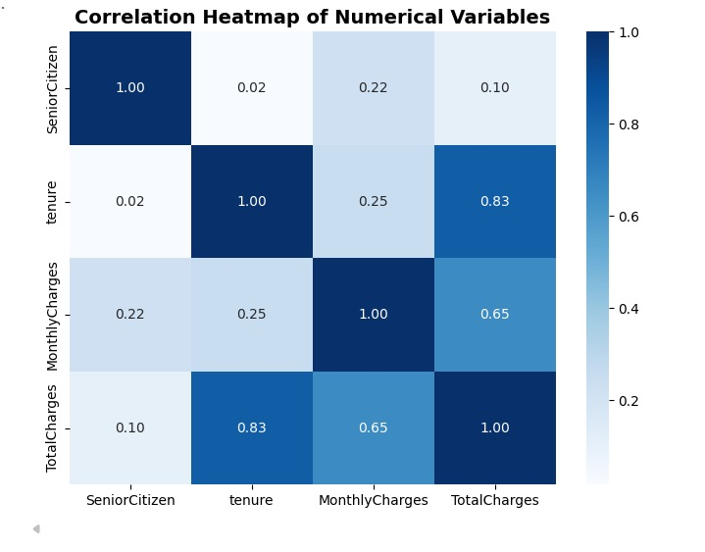
Tenure and Charges Show Strong Correlation with Churn Behavior
CORRELATION HEATMAP
KEY INFLUENCER ANALYSIS
Top Churn Drivers (Likelihood Multiplier)
6.32x
Month-to-month contract
3.63x
No Online Security
3.51x
No Tech Support
2.89x
Fiber Optic internet service
2.65x
Electronic Check payment
2.48x
No Online Backup
Correlation findings: Tenure correlates strongly with TotalCharges (0.83) and MonthlyCharges (0.65), indicating that longer-tenured customers accumulate higher charges. The Key Influencer analysis in Power BI confirms that contract type is the dominant churn predictor, with month-to-month customers being over 6x more likely to churn than those on long-term contracts.
Source: Python Correlation Analysis & Power BI Key Influencer Visual
13

Slide 14
04
STRATEGIC RECOMMENDATIONS
Data-driven retention strategies to reduce churn and improve customer loyalty
14

Slide 15
Five Priority Actions to Reduce Churn and Improve Retention
01
Promote Long-Term Contracts
02
Improve Onboarding Experience
Offer discounts and loyalty rewards for 1-year and 2-year contract commitments. Month-to-month contracts drive 88.5% of churn — converting even 20% would save ~331 customers.
Implement structured onboarding for the first 10 months when churn peaks. Proactive check-ins, tutorials, and dedicated support can reduce early-tenure attrition.
03
Bundle Value-Added Services
04
Review Pricing Strategy
Package Online Security, Tech Support, and Device Protection with core internet plans. Customers without these services churn at 2.5-3.6x higher rates.
Reassess Fiber Optic pricing for high-value users. Higher monthly charges correlate with increased churn — consider tiered pricing or loyalty discounts.
05
Target High-Risk Customers Proactively
Deploy predictive churn scoring to identify at-risk customers before they leave. Focus on: month-to-month contracts + Fiber Optic + Electronic Check + no value-added services + tenure < 10 months. Proactive outreach with personalized retention offers can prevent 30-40% of predicted churn.
Source: Analysis-derived recommendations based on churn driver findings
15

Slide 16
DATA-DRIVEN RETENTION DELIVERS RESULTS
This analysis demonstrates how business analytics transforms customer data into actionable insights that support strategic decision-making and reduce customer churn.
Implementing these recommendations can improve customer loyalty
and drive sustainable profitability
Thank You
Prepared by Gloria Ubah | AnalystLab Africa Internship Program
16

